Slide 1

Part IV Case studies
Fausto Carcassi

Slide 2
Intro & structure
We have seen how pLoT models work
This has been applied to many domains in the literature
Four examples today:
Kinship
Numerals
Visual concepts
Binary sequences
Part I | Introduction: On the very idea of an LoT
Part II | Technical background
Part III | Bayesian program induction (LOTlib3)
Part IV | Case studies
Part V | Summary & Future prospects

Slide 3
Kinship - Mollica & Piantadosi (2021)

Slide 4
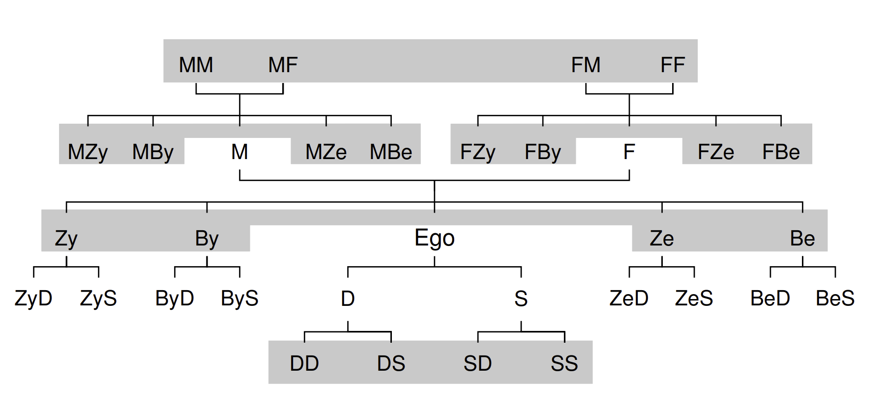
Kinships terms
Mollica & Piantadosi (2021), Logical word learning: The case of kinship.
Kinship terms express relative positioning in a family
Rich logical structure: they express complex relations.
Kemp & Regier (2012)

Slide 5
Kinships terms – Data
A single datapoint is a collection of four objects:
Speaker who uses the kinship word
Word used by the speaker
Referent identified by the word
Context consists of a family tree
The child sees datapoints & infers the meaning of kinship terms!

Slide 6
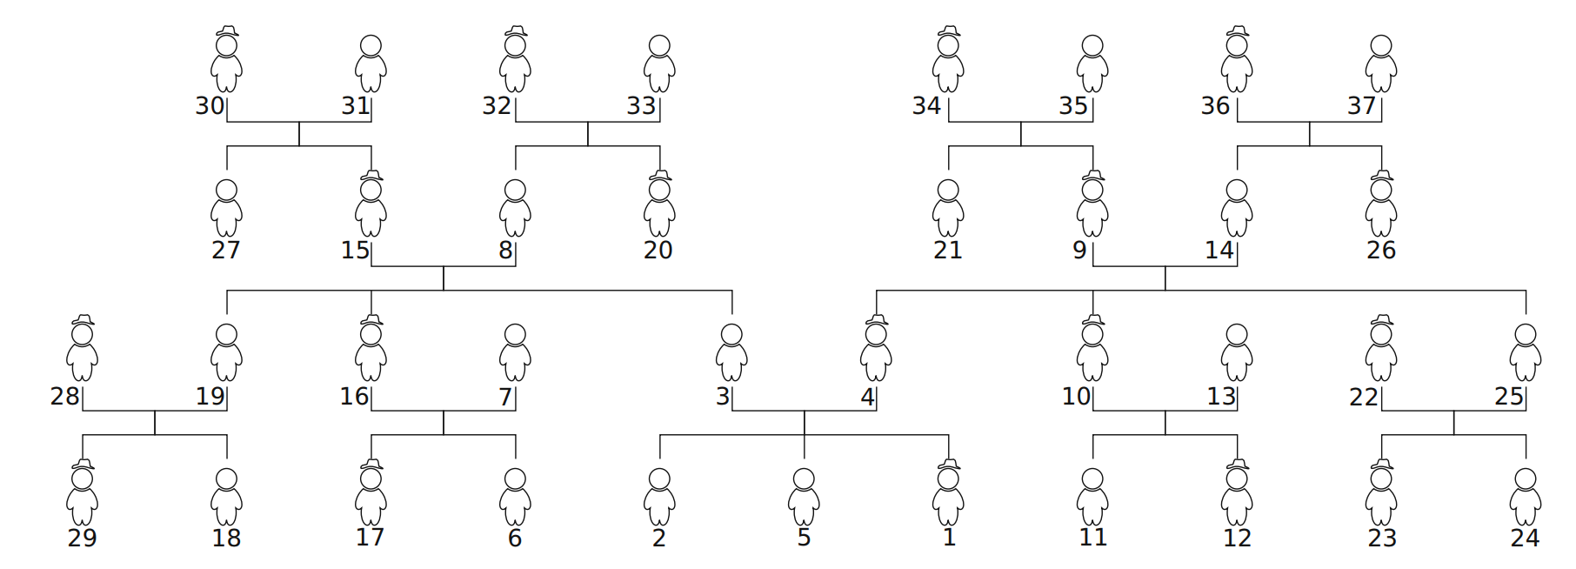
Kinships terms – Hypothesis space
Hypothesis: set of people in a family from the point of view of the speaker.
37 possible people
Numbered by rank of number of interactions with the speaker:

Slide 7
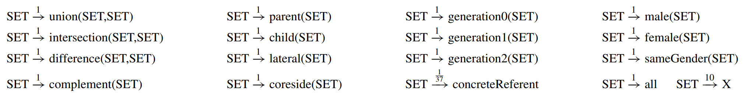
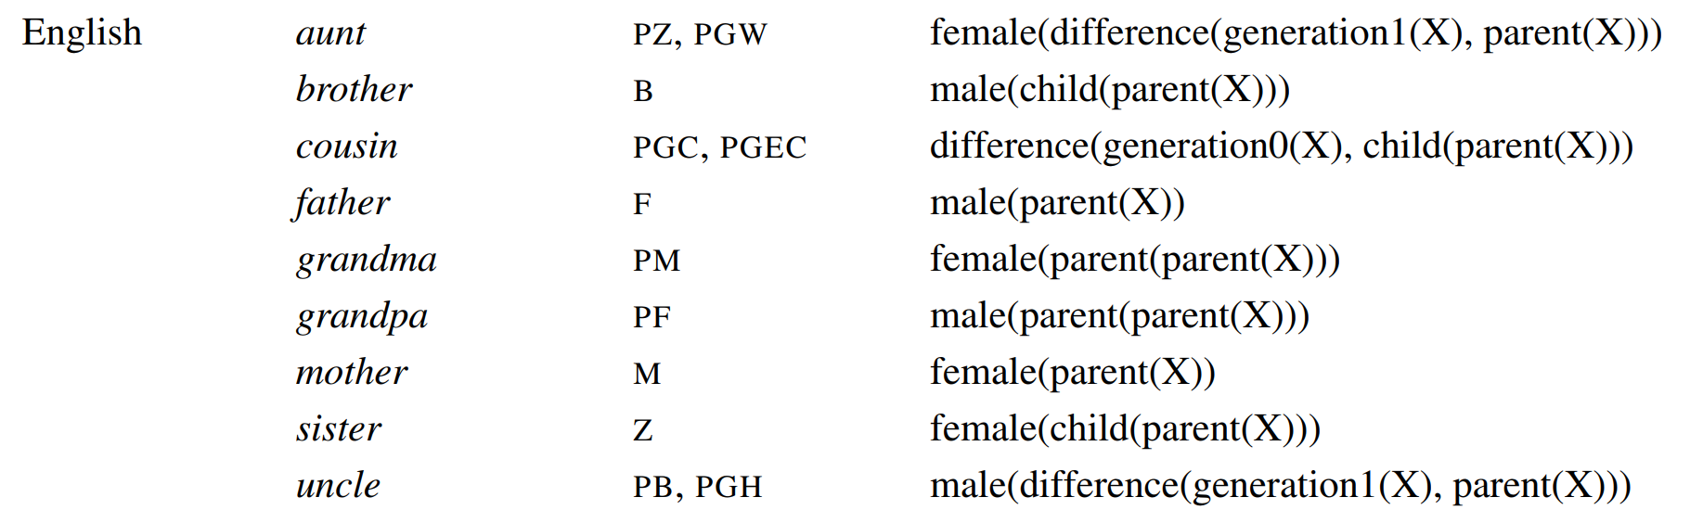
PCFG & induced prior
The PCFG contains the following primitives:
E.g.,

Slide 8
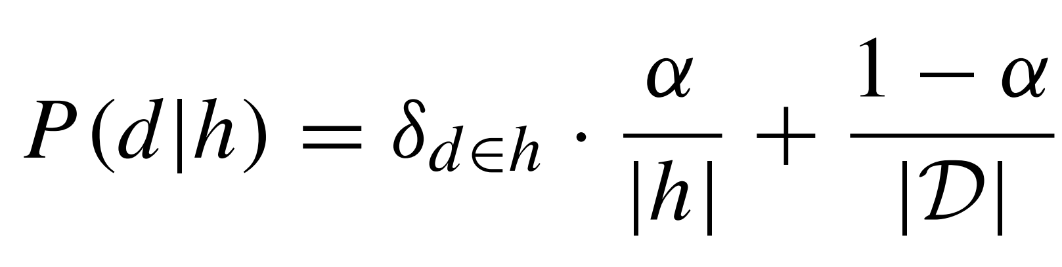
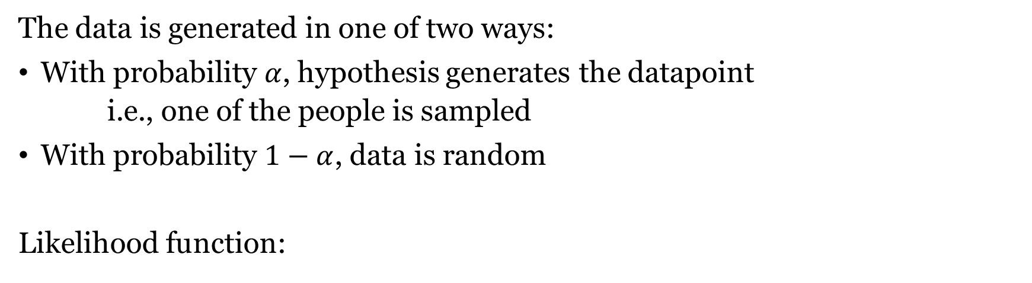
Likelihood function
The data is generated in one of two ways:
With probability $α$, hypothesis generates the datapoint
i.e., one of the people is sampled
With probability $1−α$, data is random
Likelihood function:
Whether d belongs to h
Size of h
Size of domain

Slide 9
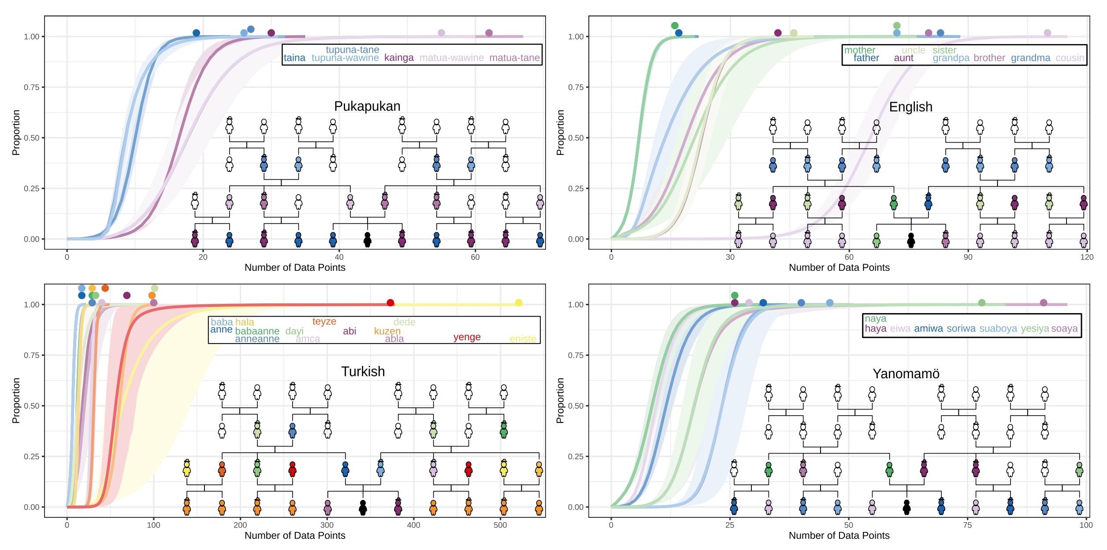
Results

Slide 10
Results
For few datapoints, preference for concrete reference (single individuals) over classes of individuals.
This is consistent with what children do!
Predicts overextension
The phenomenon where children learn a larger category that includes more individuals than the word’s true reference.
Characteristic-to-defining shift
Young children over-extend with characteristic features (“robbers are mean”) vs defining features (“robbers steal things”).

Slide 11
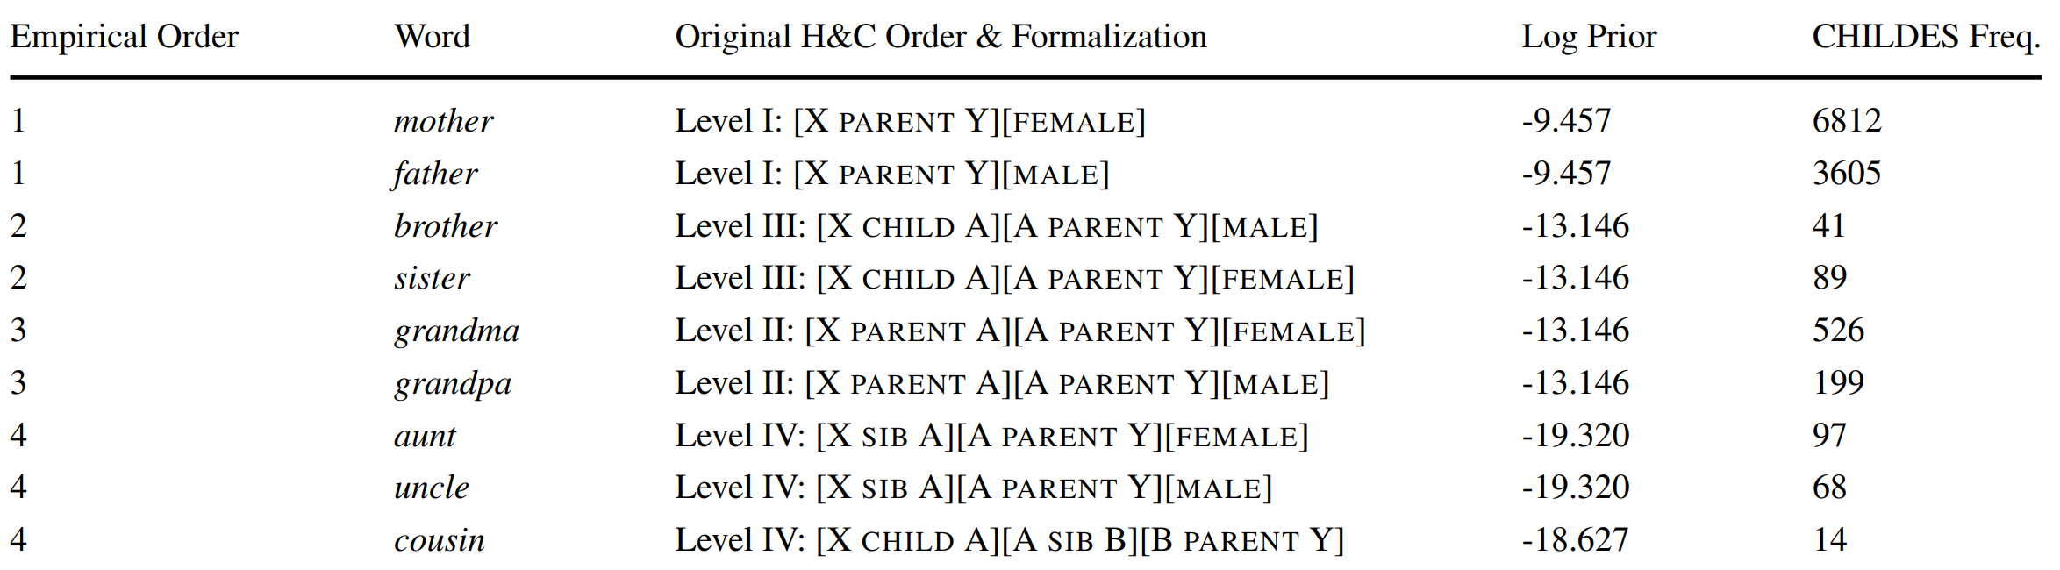
Results
Order of acquisition in model mostly align with children:
Much more in paper (e.g. experimental results) but we do not have time!

Slide 12
Numbers - Piantadosi et al (2012)

Slide 13
Learning Numerals with an LoT
Piantadosi et al (2012), Bootstrapping in a language of thought: A formal model of numerical concept learning.
Regular patterns in number systems acquisition.
The first learn to recognize small sets of size 1, then 2, then 3, etc.
At about 3;6 they learn the full recursive system
Cardinal Principal learners
Qualitative jump rather than smooth progress!
Can pLoT reproduce qualitative conceptual jumps?

Slide 14
Learning Numerals with an LoT
Three choices for functions encoding meaning of number words:
Number word to a predicate on sets n –> “Are there n?”
Set to a number word S –> “How many are there?”
Objects in the situation to set n –> “Construct n”
Children can do all these three things; no clear empirical evidence.
They go the second way: from a set to a number word.

Slide 15
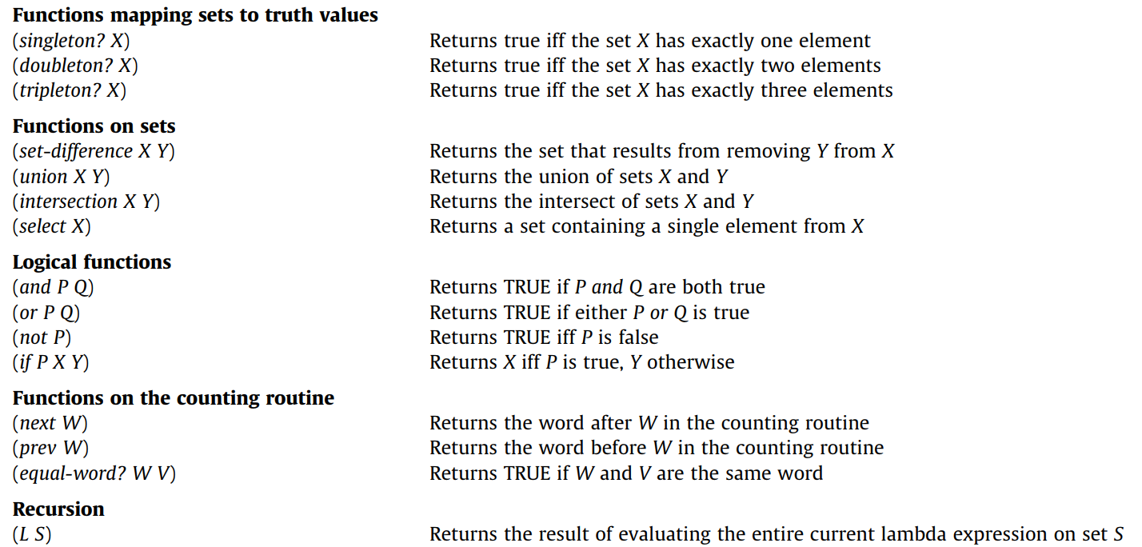
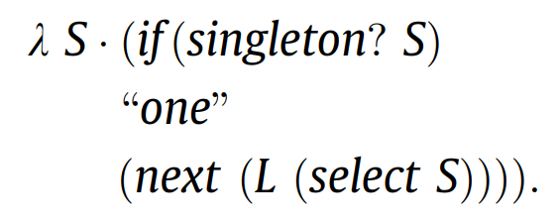
Learning Numerals with an LoT

Slide 16
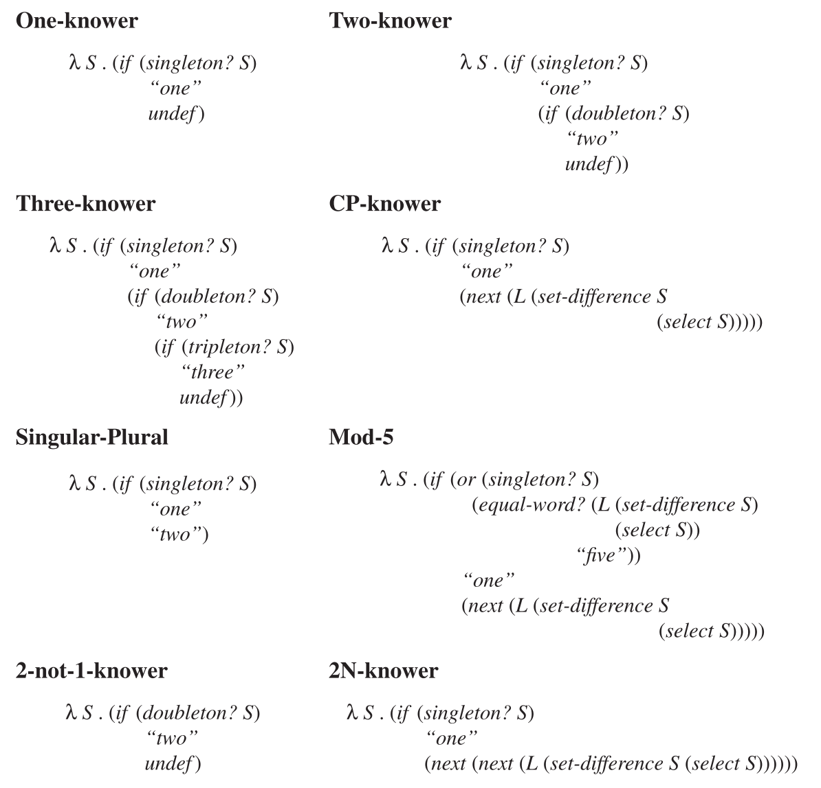
Learning Numerals with an LoT

Slide 17
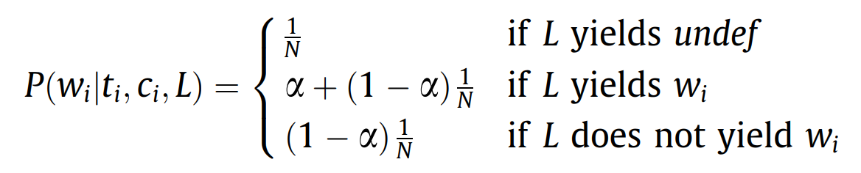
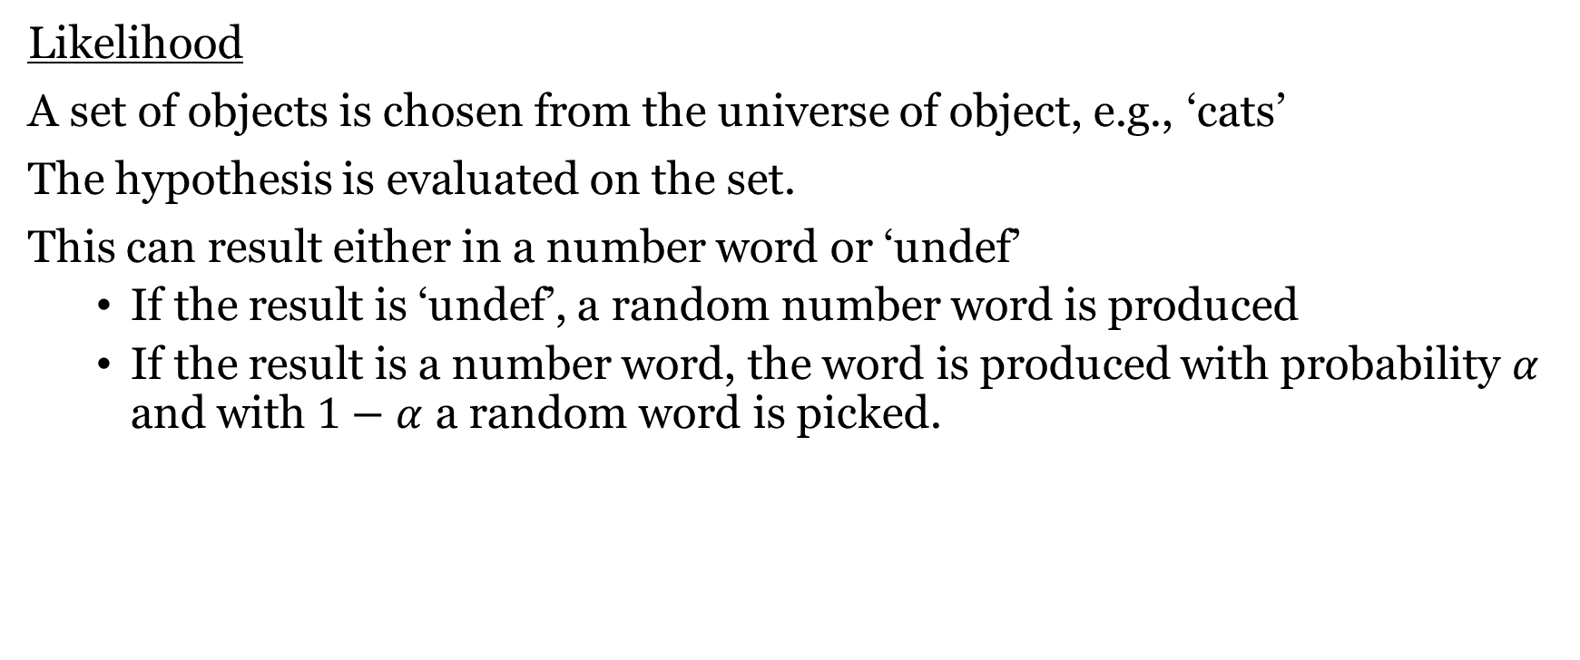
Learning Numerals with an LoT
Likelihood
A set of objects is chosen from the universe of object, e.g., ‘cats’
The hypothesis is evaluated on the set.
This can result either in a number word or ‘undef’
If the result is ‘undef’, a random number word is produced
If the result is a number word, the word is produced with probability $α$ and with $1−α$ a random word is picked.

Slide 18
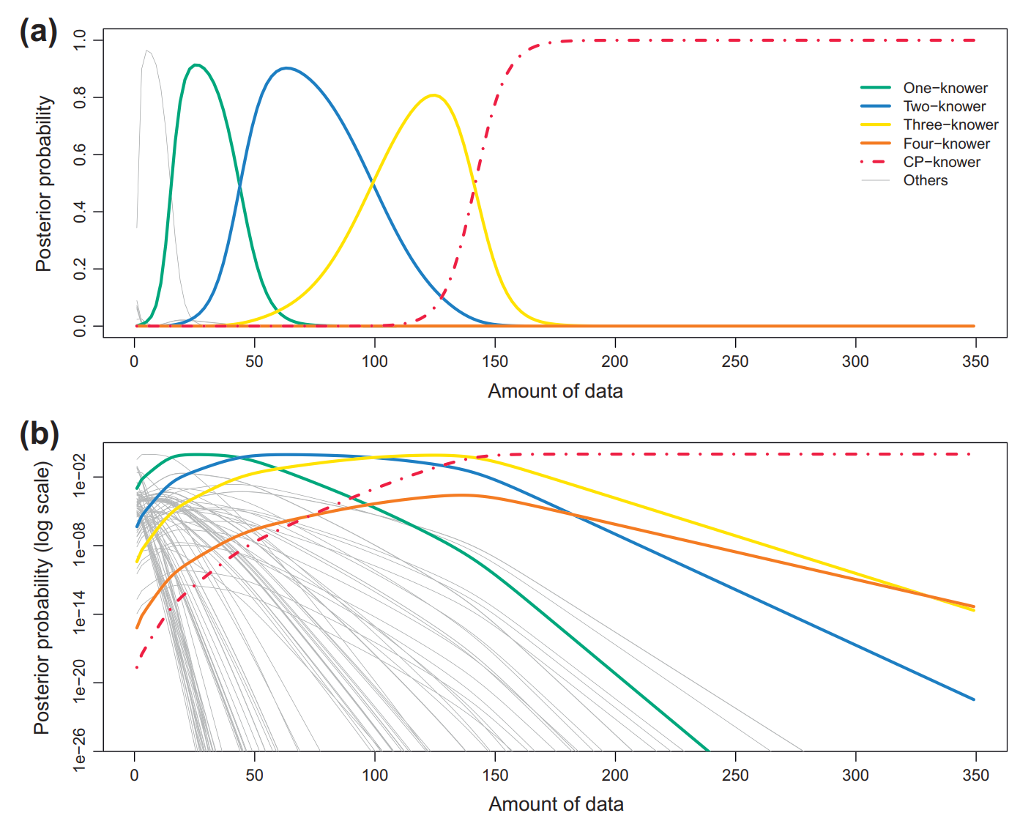
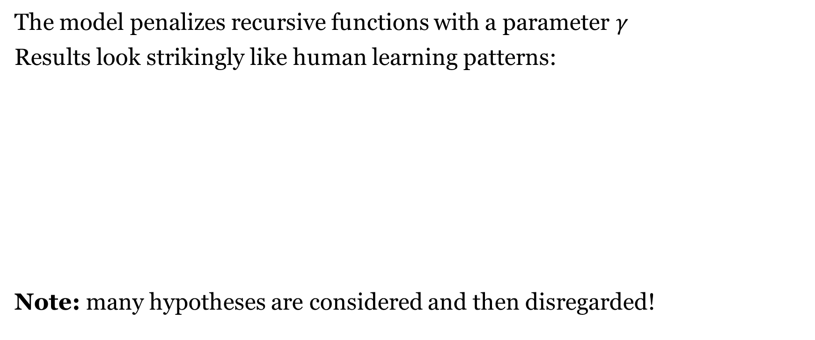
Learning Numerals with an LoT
The model penalizes recursive functions with a parameter $γ$
Results look strikingly like human learning patterns:
Note: many hypotheses are considered and then disregarded!

Slide 19
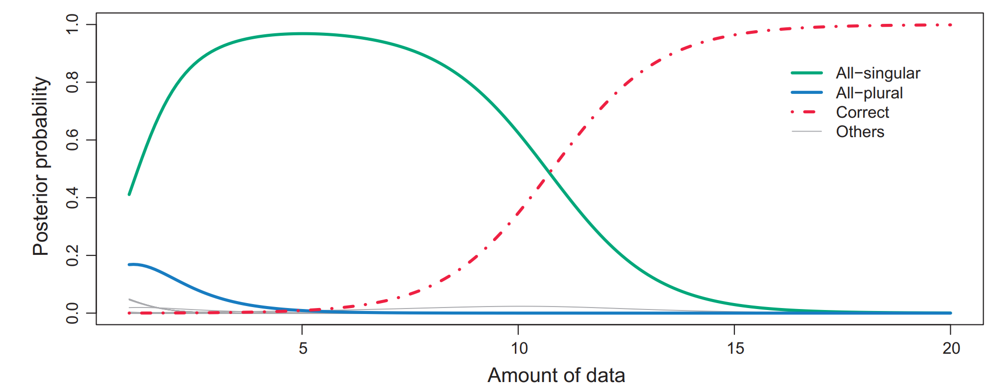
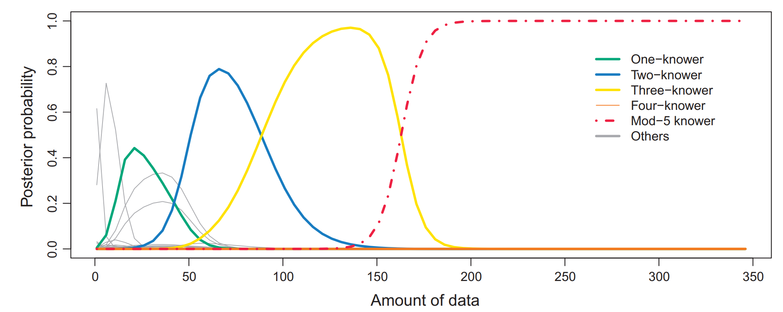
Learning Numerals with an LoT
The same LoT
on singular/plural morphology
And mod-n systems
(e.g. days of the week)

Slide 20
Visual concepts - Overlan et al (2017)

Slide 21
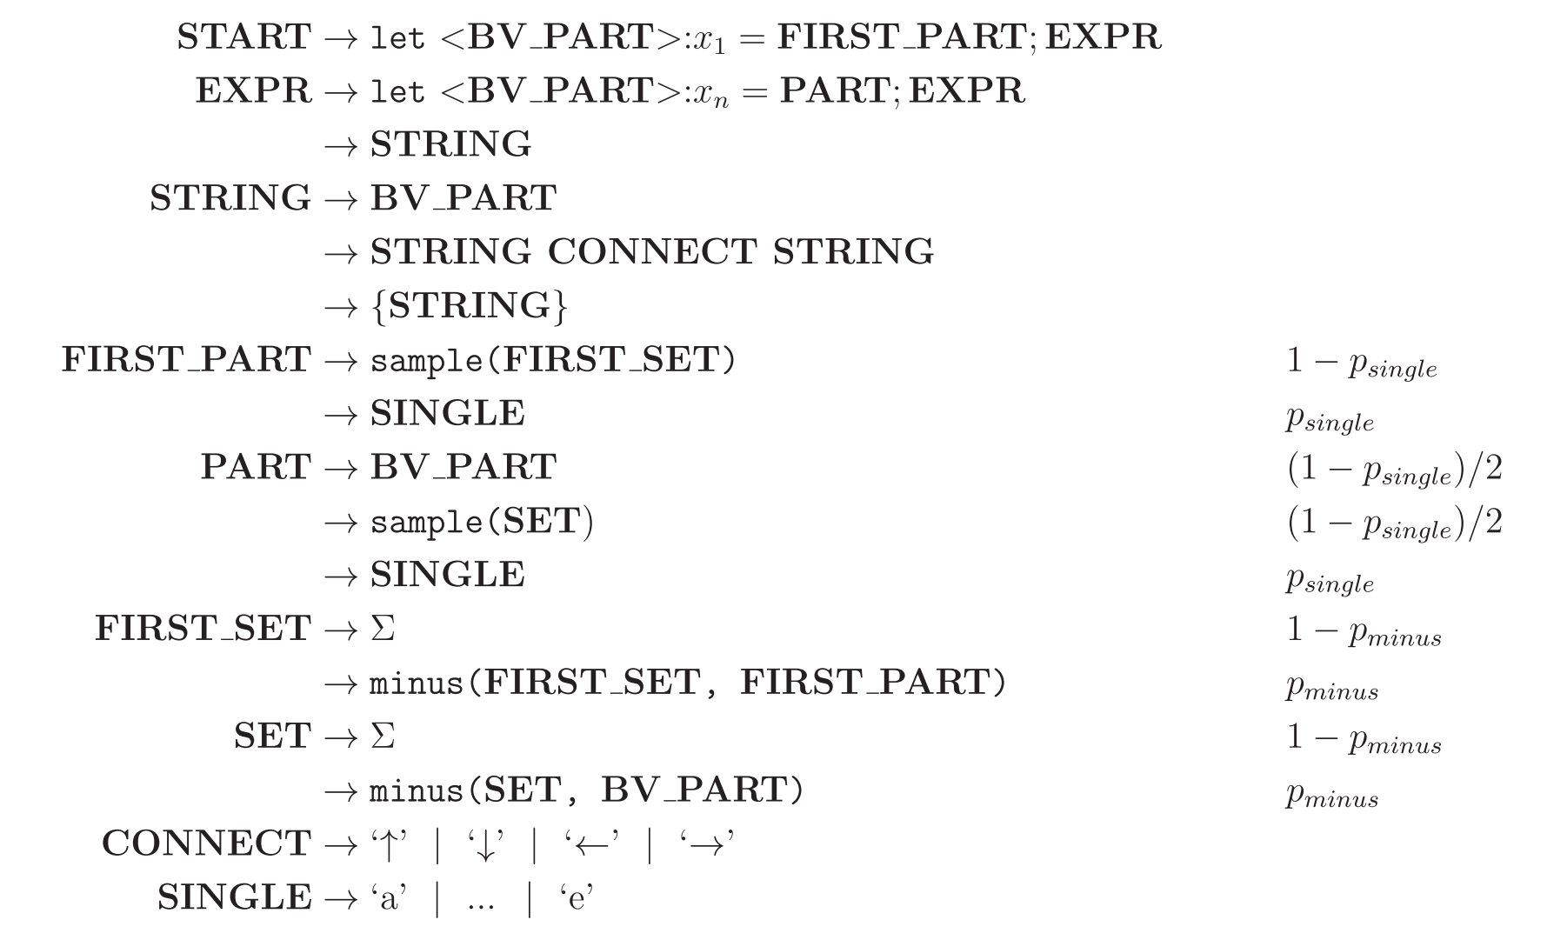
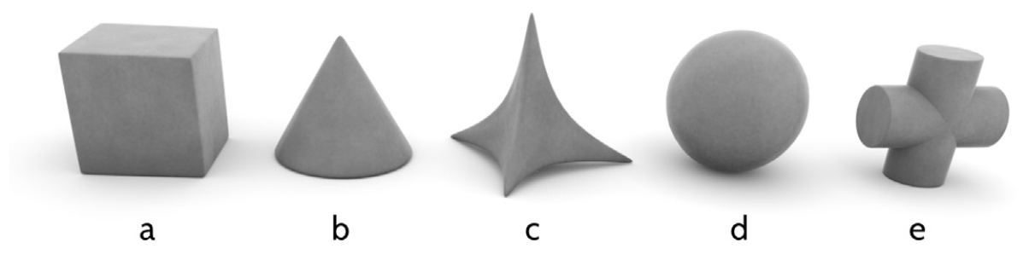
Visual Concept Learning in an LoT
Overlan et al (2017), Learning abstract visual concepts via probabilistic program induction in a Language of Thought
pLoT model of 3-d objects

Slide 22
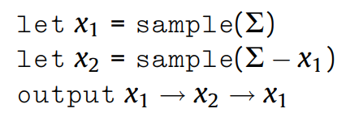
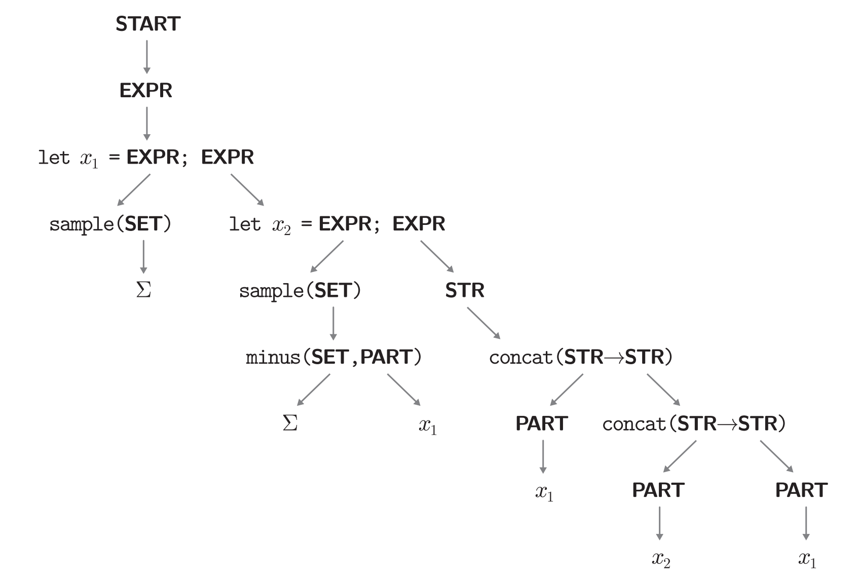
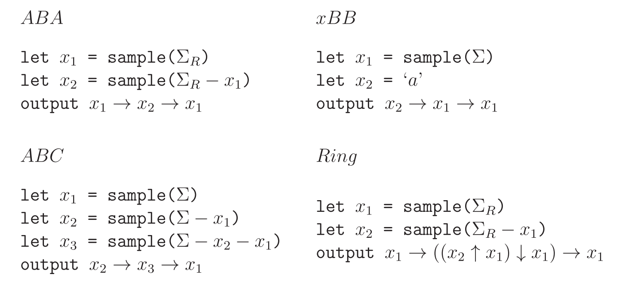
A derivation & some categories

Slide 23
Experimental design
120 participants
Instruction stage
Show all possible objects
Training stage
Show participants three
examples of a concept
Testing stage
Show 24 new items
Ask whether the concept applies

Slide 24
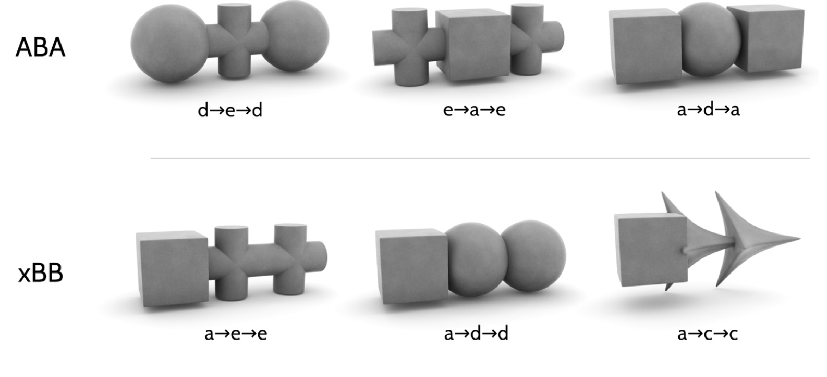
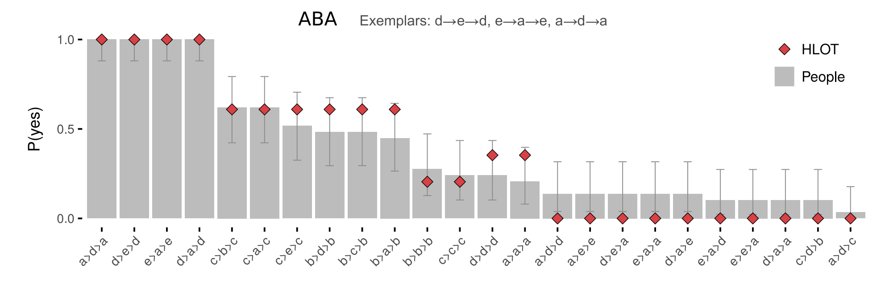
Experimental results

Slide 25
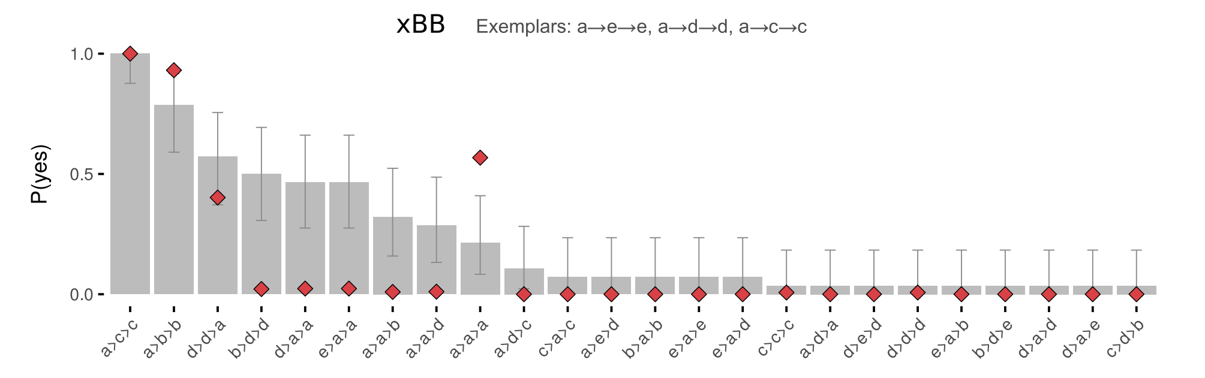
Experimental results

Slide 26
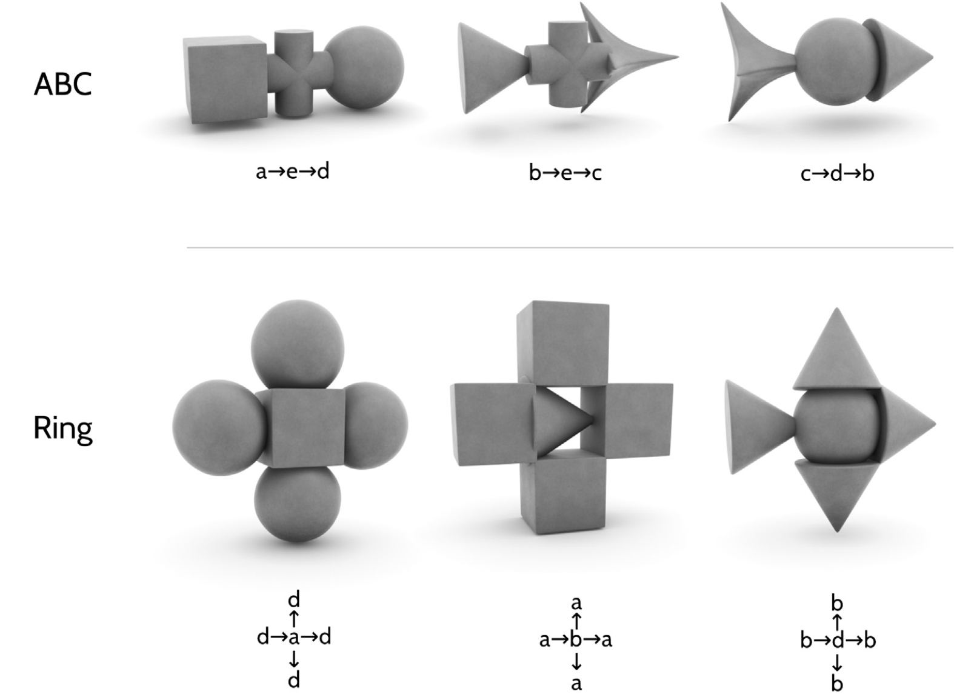
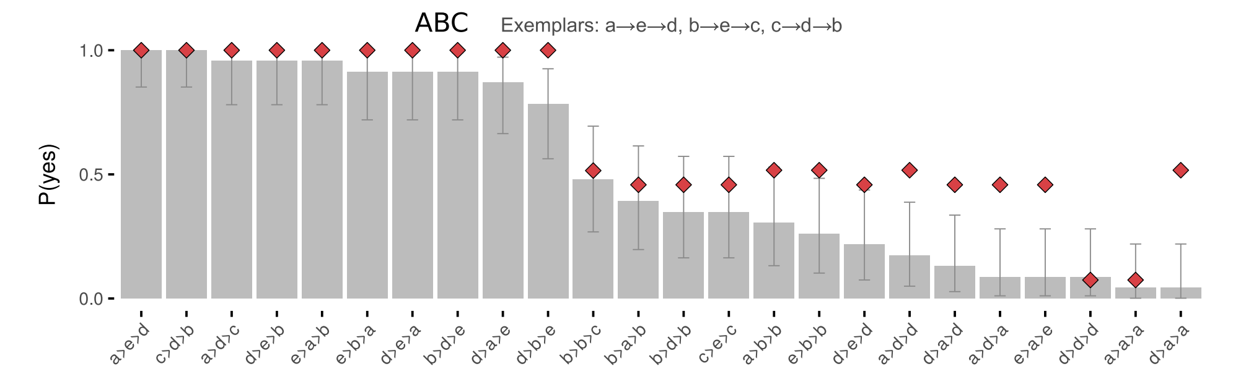
Experimental results

Slide 27
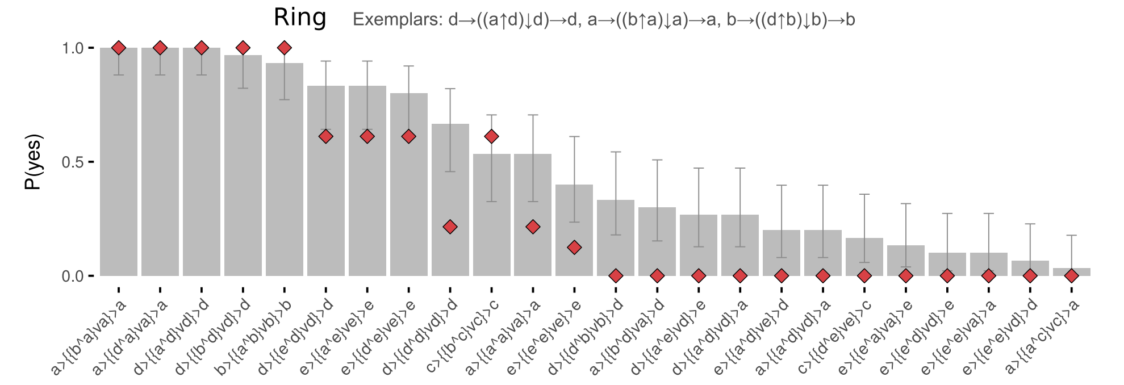
Experimental results

Slide 28
Sequences - Planton et al (2021)

Slide 29
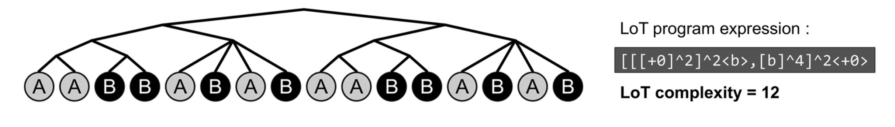
Sequence Learning in an LoT
Planton et al (2021), A theory of memory for binary sequences: Evidence for a mental compression algorithm in humans
New: Doesn’t use natural language.
pLoT model of how humans deal with binary sequences
E.g., {0,1}*
But e.g. it can be two pitches (auditory stimuli)

Slide 30
Sequence Learning in an LoT
Staying (“+0”)
Moving to the other item (here denoted ‘b’)
Repetition (“^n”, where n is any number),
Possibly with a variation in the starting point
Denoted by <x> where x is an elementary instruction, either +0 or b
Embedding of expressions is represented by…
brackets (“[. . ..]”)
concatenation by commas (“,”)

Slide 31
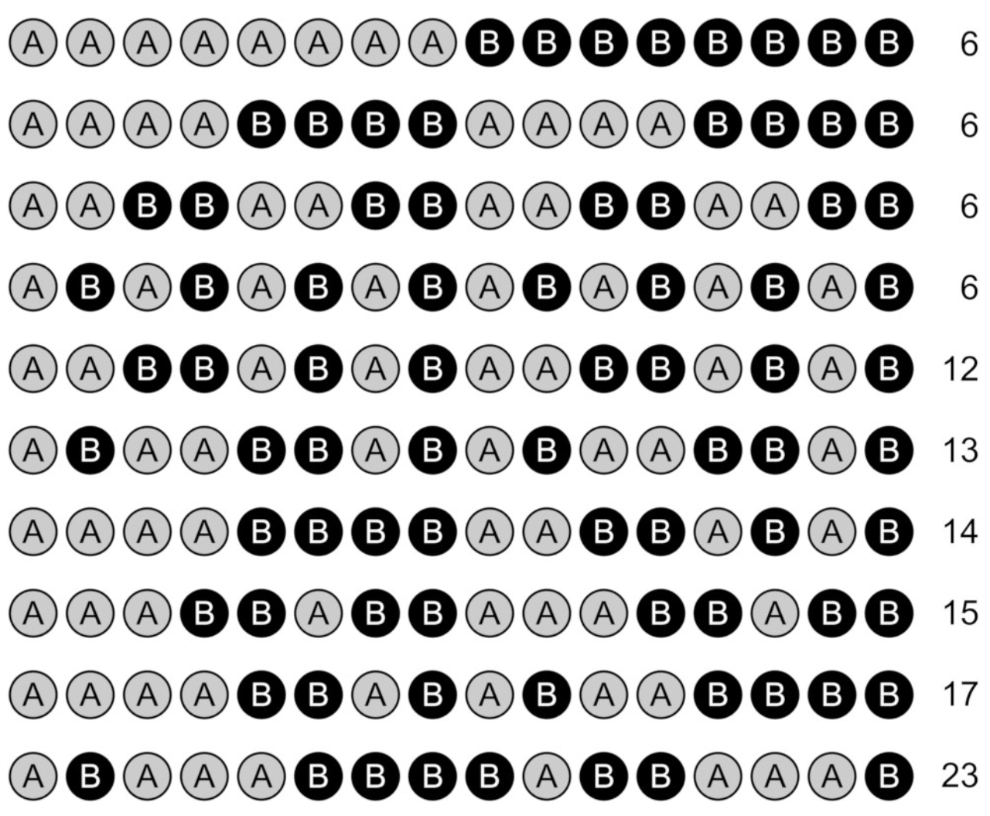
Which set has most complex sequences?

Slide 32
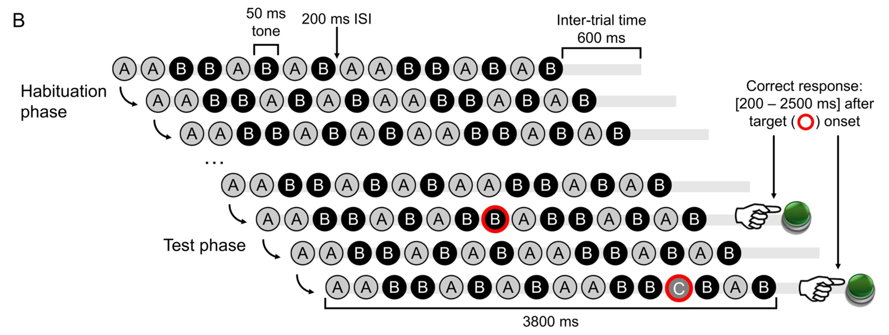
Sequence Learning in an LoT
‘Sequence violation’ experimental paradigm:
Empirical hypothesis: for equal sequence length, error rate and response time in violation detection increase with sequence complexity.

Slide 33
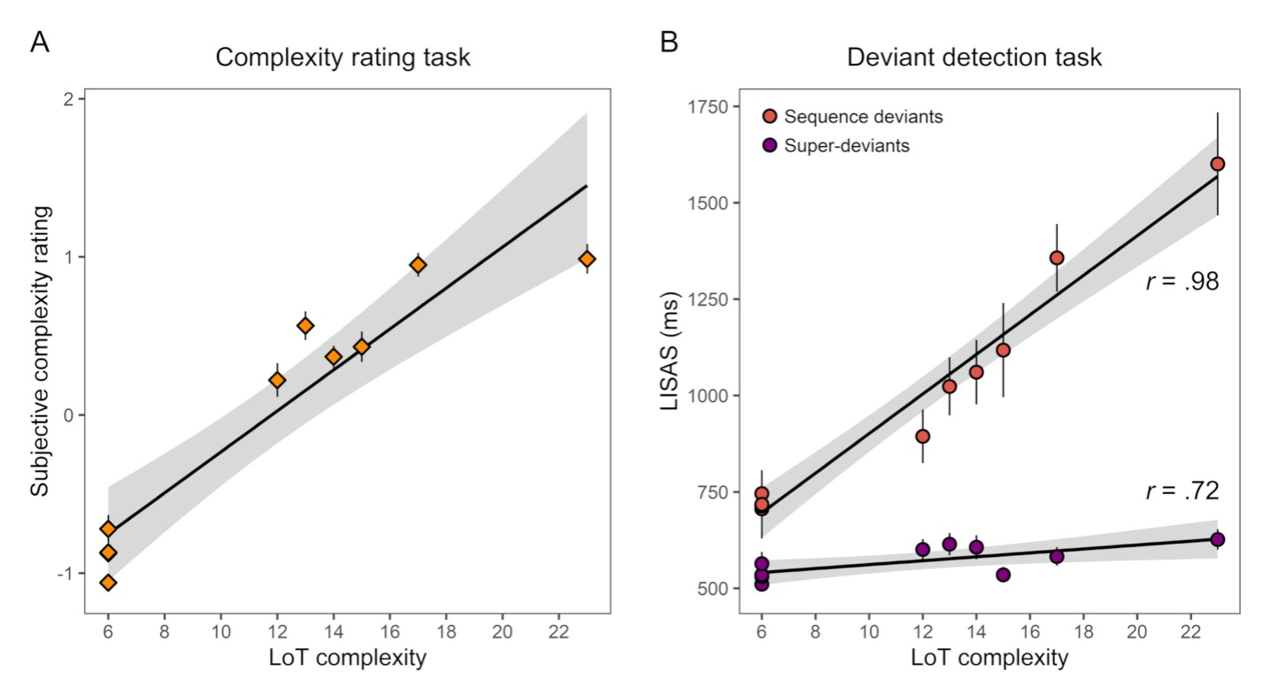
Sequence Learning in an LoT
First experiment results (16-items sequences)
Deviants identification
Sequence deviants
Switched note btw A and B
Superdeviant
A new note is introduced
Participants’ subjective complexity evaluations (left)
LISAS Linear Integrated Speed-Accuracy Score combines response times & error scores

Slide 34
Taking stock

Slide 35
The variety of applications of the pLoT
Linguistic
Non-linguistic
Kinship
Numerals
Visual concepts
Binary sequences

Slide 36
The variety of applications of the pLoT
Kinship
Numerals
Visual concepts
Binary sequences
Reflected categorization
Lower-level cognition
(Reaction times, errors)

Slide 37
The variety of applications of the pLoT
Familiar
New
Kinship
Numerals
Visual concepts
Binary sequences

Slide 38
The variety of applications of the pLoT
Typological
Kinship
Numerals
Visual concepts
Binary sequences
Acquisition
Experimental

Slide 39
The variety of applications of the pLoT
Abstract
Visual
Kinship
Numerals
Visual concepts
Binary sequences
Auditory

Slide 40
Intro & structure
Four examples today:
Kinship
Numerals
Visual concepts
Binary sequences
Part I | Introduction: On the very idea of an LoT
Part II | Technical background
Part III | Bayesian program induction (LOTlib3)
Part IV | Case studies
Part V | Summary & Future prospects

